Slide 1

COMPUTER CASE
PRESENTATION

Slide 2
What Is a PC Case?
A PC case, also called a cabinet, chassis, or tower, is the outer box that serves as the foundation of any computer build. It's more than just a container—it's the physical body that holds, protects, and organizes every essential component of your PC. Whether you're building your first gaming rig or upgrading an existing system, understanding what goes into choosing and working with a PC case is fundamental to creating a reliable, efficient computer.
Think of a PC case as the skeleton of your build. Just as your skeletal system protects vital organs and provides structure, a PC case protects your motherboard, graphics card, power supply, and cooling system while providing the framework that keeps everything organized and functional.

Slide 3
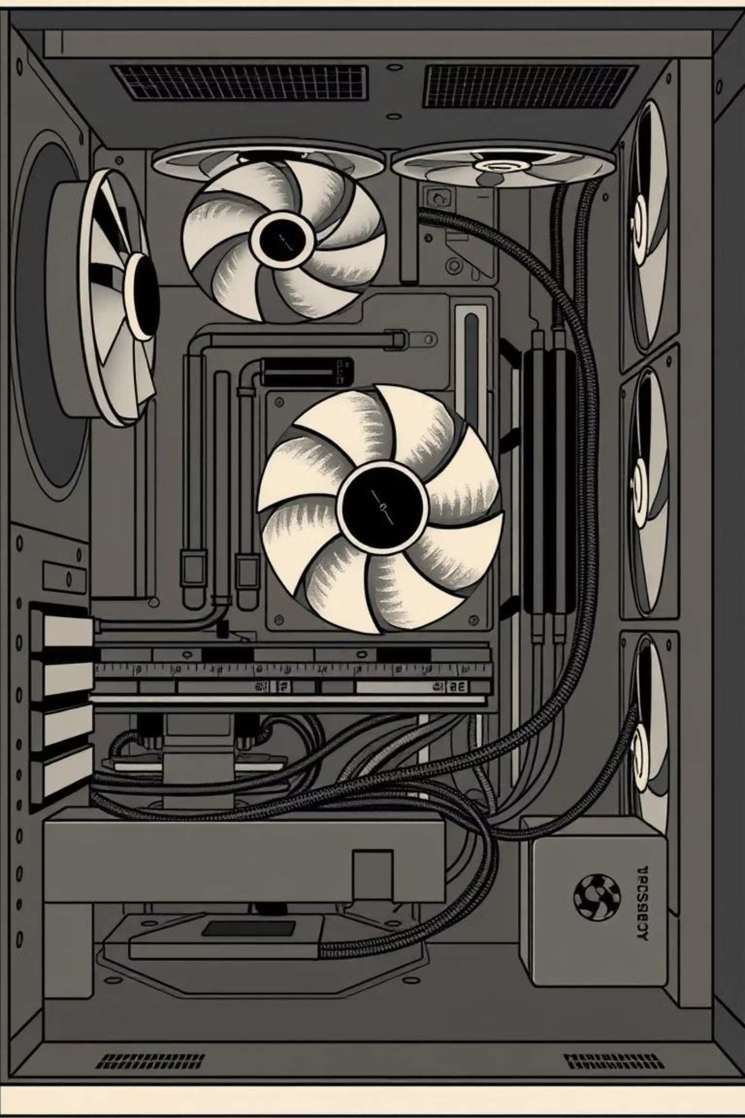
Why Your PC Case Matters
Protection & Safety
Cooling & Airflow
Shields internal components from dust, accidental damage, and environmental hazards
Enables proper ventilation and air circulation to keep your hardware running cool
Organization
Provides dedicated spaces for components and clean cable management
Beyond these core functions, a well-chosen PC case also contributes to your system's aesthetics. Modern cases feature transparent panels, RGB lighting compatibility, and sleek designs that let you showcase your build. Easy access to front ports—USB headers, audio jacks, and power buttons—ensures convenient daily use. The right case makes your PC not just functional, but a piece of hardware you're proud to display.

Slide 4
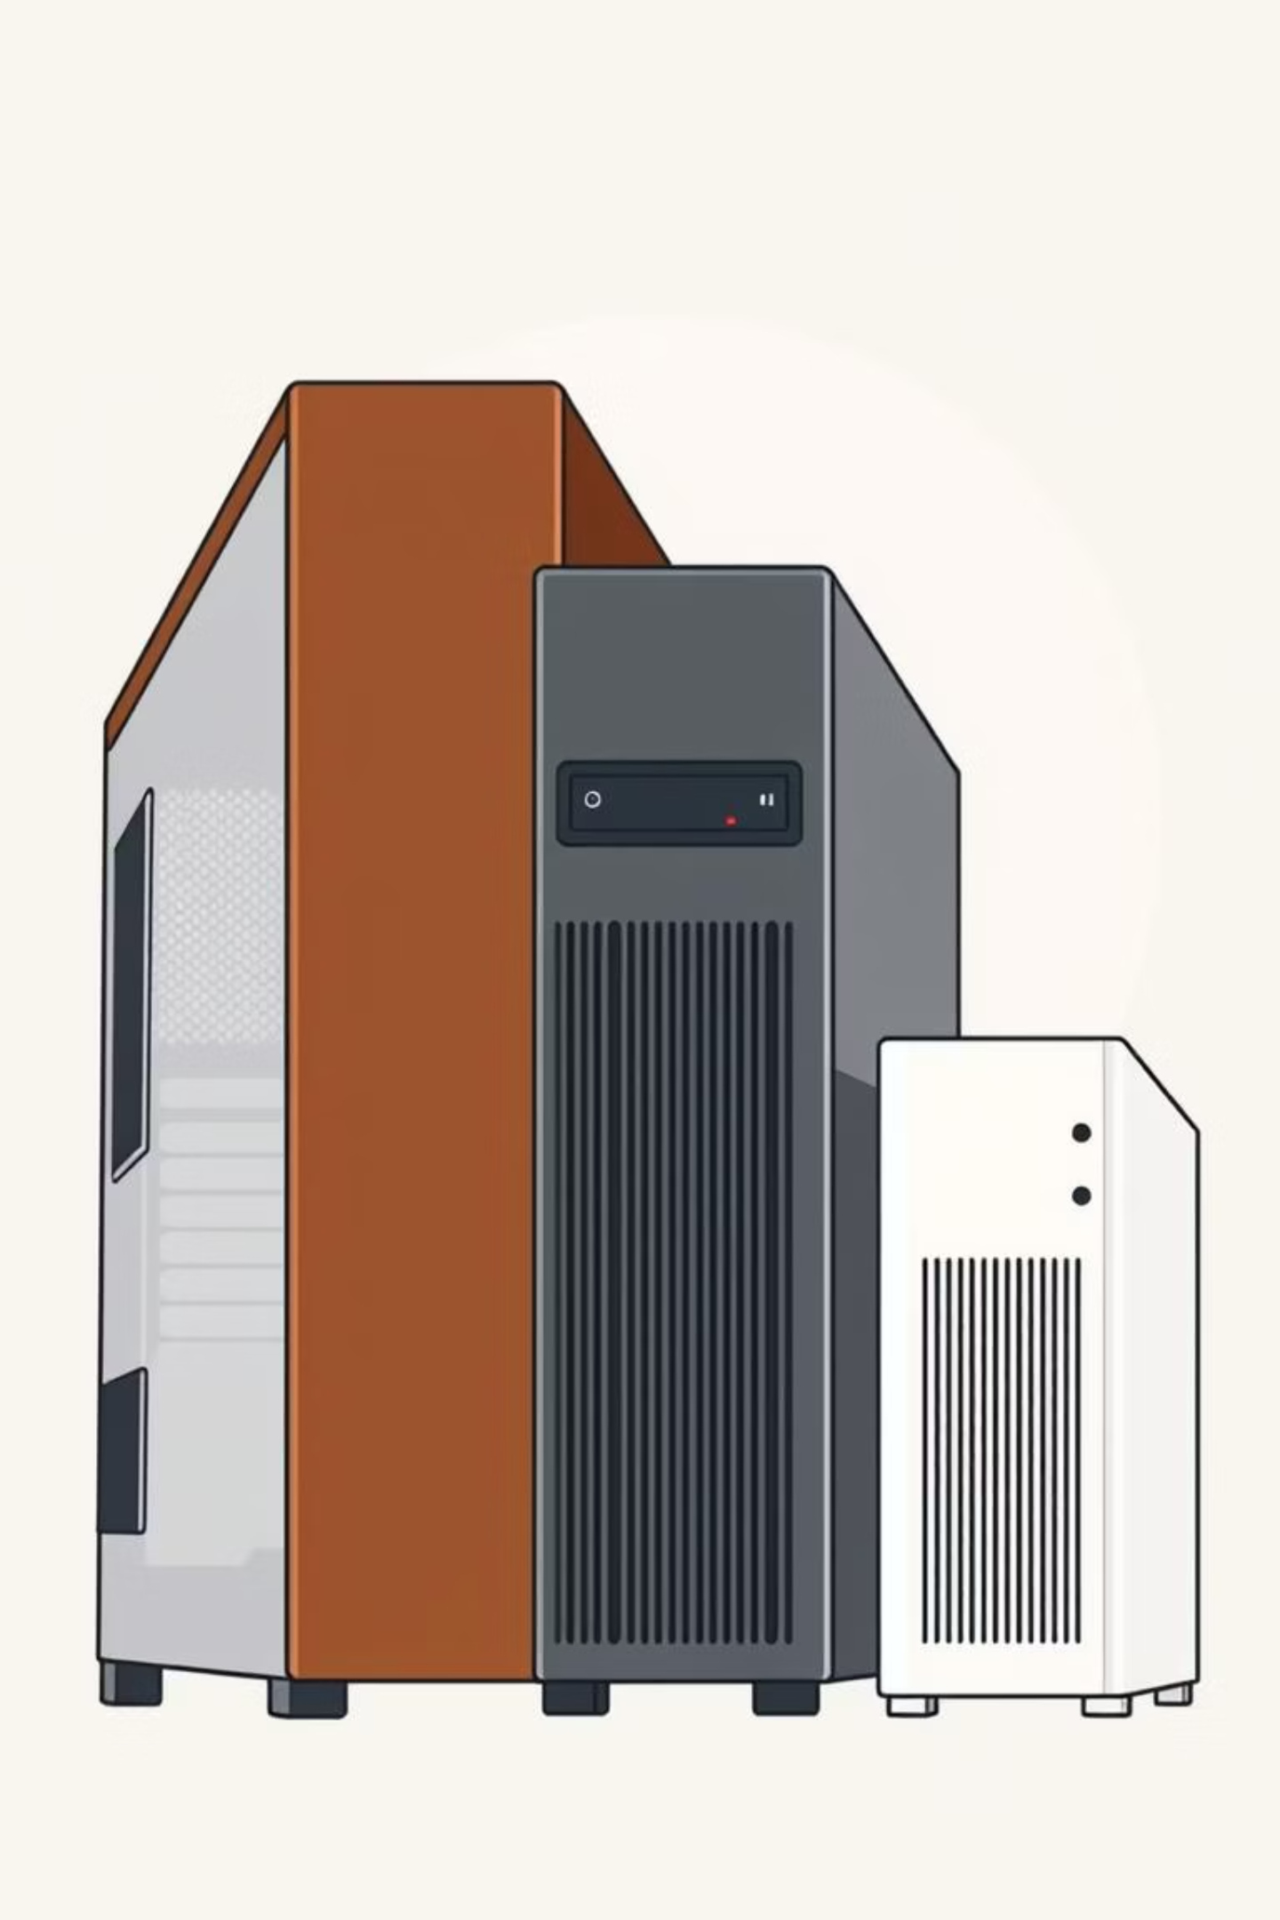
Understanding PC Case Types
PC cases come in three main sizes, each designed for different needs and spaces:
Full Tower
The largest option, measuring roughly 20-24 inches tall. Perfect for high-end gaming builds, workstations, and systems with multiple graphics cards or extensive cooling solutions. Offers maximum internal space and airflow potential.
1
Mid Tower
The Goldilocks of cases—mid-sized and the most popular choice. Fits standard ATX motherboards and most components while remaining space-efficient. Ideal for gaming and general-purpose builds without consuming excessive desk space.
2
Mini Tower
3
Compact and portable, designed for small spaces and minimalist setups. Supports Mini-ITX or Micro-ATX motherboards. Great for LAN parties, small media centers, or anyone with limited space who still wants a capable PC.

Slide 5
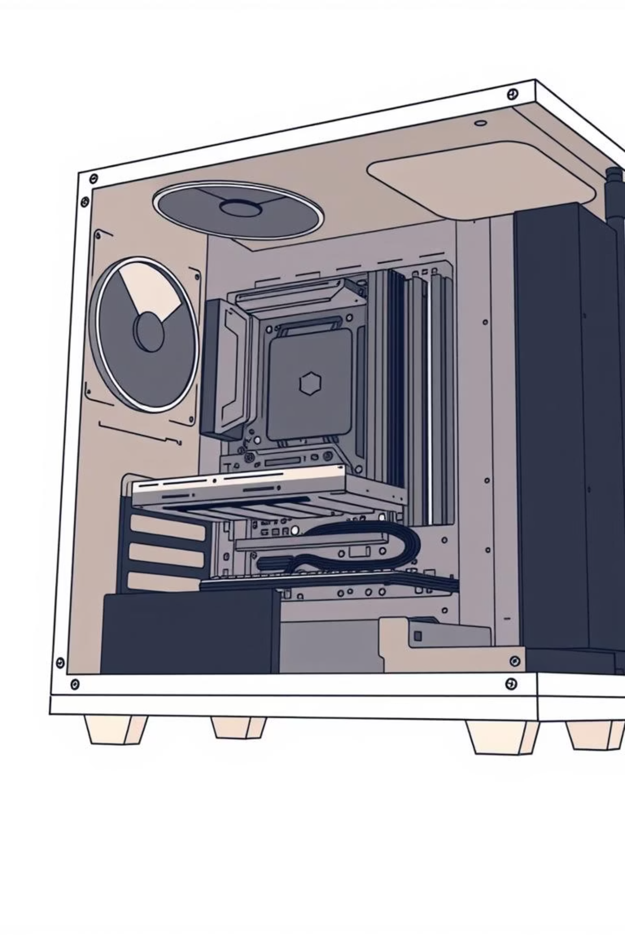
Inside Your Case: Key Components
Structural Elements
Thermal & Interface Features
Motherboard Tray – Flat panel that securely mounts your motherboard, typically with standoffs for proper spacing
Cooling Fan Mounts – Pre-drilled mounting points for intake and exhaust fans to maintain optimal temperatures
Drive Bays – Dedicated slots for 2.5" and 3.5" drives (SSDs and hard drives), usually featuring hot-swap capability
Front Panel Connectors – USB ports (3.0 and Type-C), 3.5mm audio jacks, power buttons, and LED headers for easy access
Power Supply Area – Isolated compartment at the bottom or rear for PSU installation, keeping heat away from other components
Cable Management – Behind-motherboard routing spaces and tie-down points for clean, organized wiring

Slide 6




Modern Case Design & Materials
Today's PC cases blend form and function with sophisticated design choices:
Premium Materials
Visual Customization
Smart Cable Routing
Steel for durability, aluminum for lightweight designs, and tempered glass for stunning visual appeal and component showcasing
RGB-compatible fan mounts and lighting zones let you personalize your build with millions of color combinations
Generous behind-the-motherboard spaces and organized cable guides make building and upgrading cleaner and easier
These design elements work together to create cases that look as good as they perform. The transparency trend has revolutionized PC aesthetics, turning computer builds into decorative display pieces that showcase your hardware investment.

Slide 7
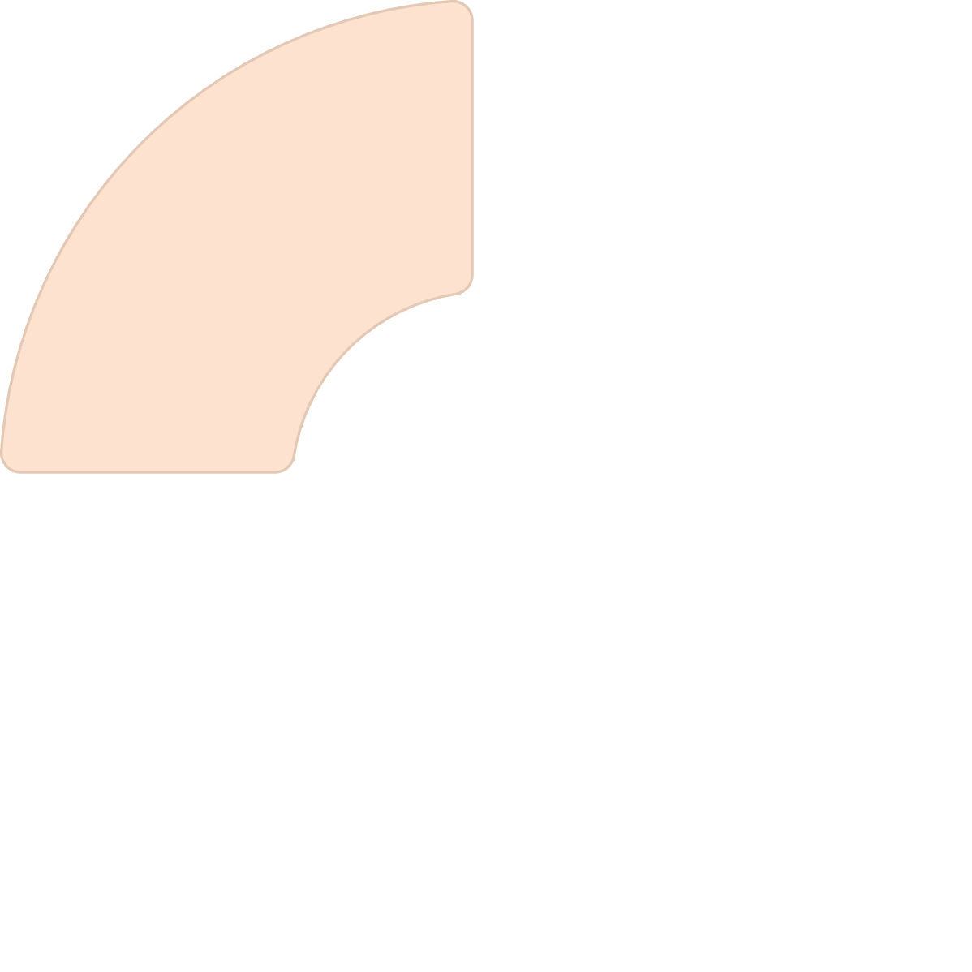
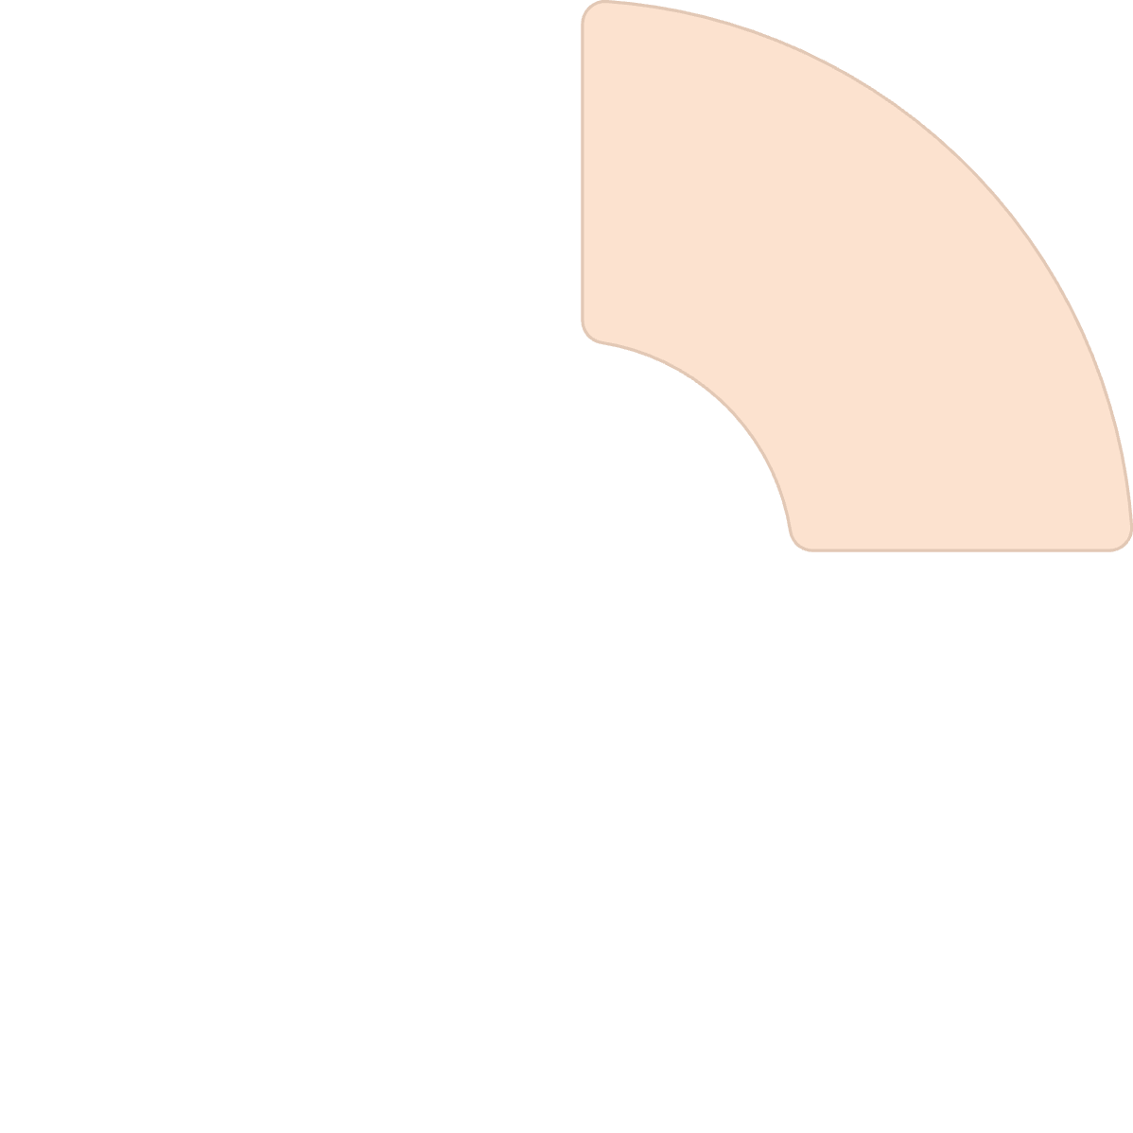

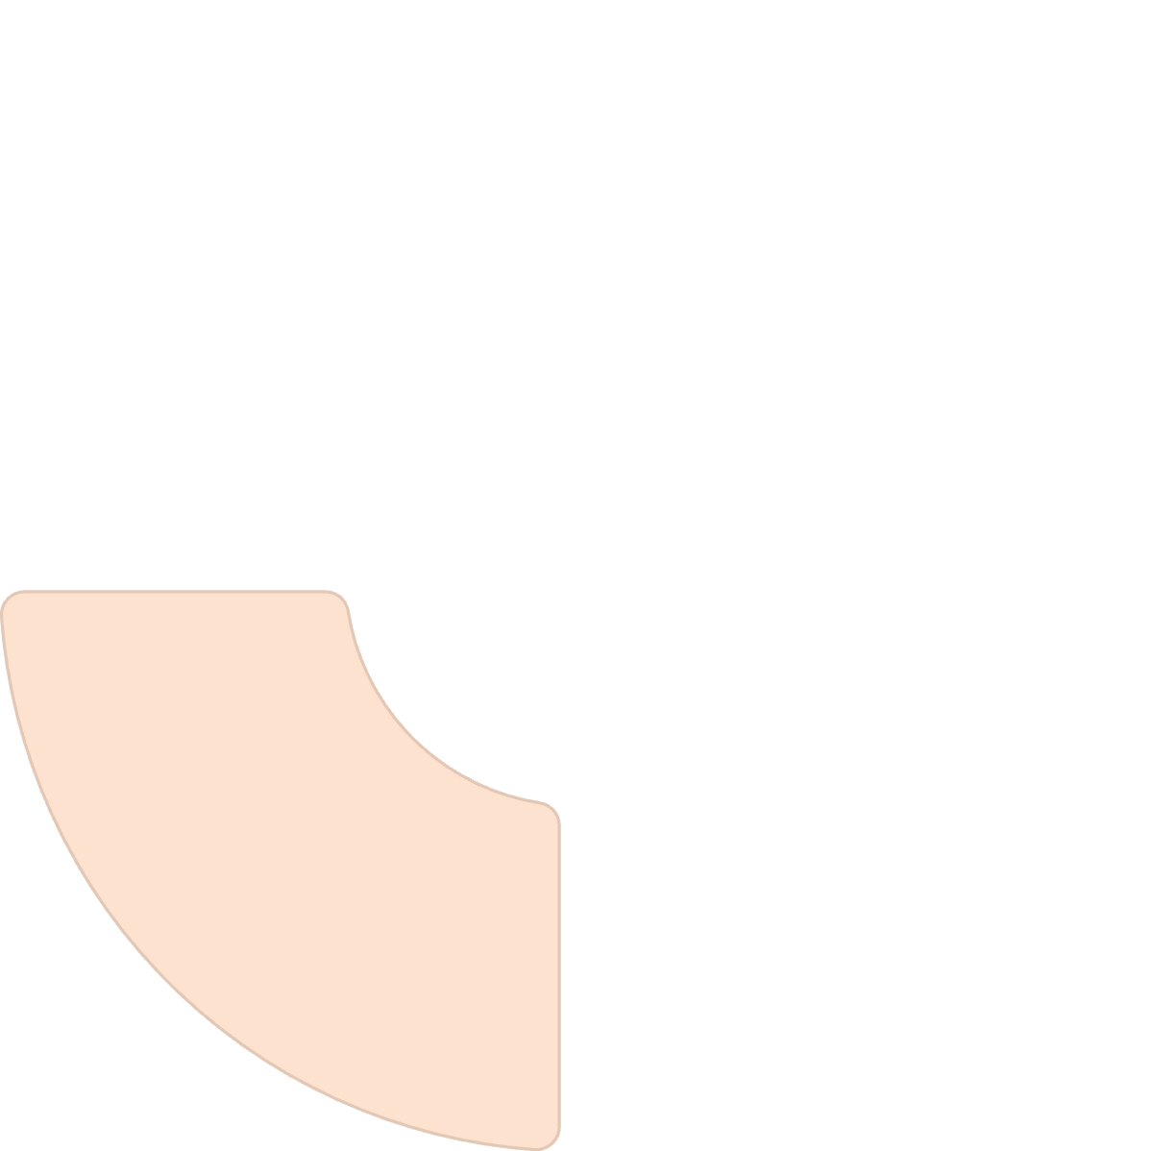




Why Case Choice Matters for Your Build
Airflow
Noise Control
Proper ventilation keeps components cool, extending their lifespan and maintaining peak performance
Dampening materials and strategic fan placement reduce operational noise for a quieter computing experience
Aesthetics
Performance
Your case is the first thing people notice about your build—make it count with a design that reflects your style
Good airflow and thermal management directly improve system stability and sustained performance
Your PC case is the foundation of any successful build. It's the body and protector of your computer, working tirelessly to keep components safe, cool, and organized. Whether you're prioritizing maximum performance through superior airflow, building a compact media center, or creating a show-stopping RGB showcase, there's a case perfectly suited to your needs. Choose wisely, and your case will serve you reliably for years to come.

